Slide 1
Introduction to
Digital Systems
CSE 4205: Digital Logic Design
Aashnan Rahman
Junior Lecturer
Department of Computer Science and Engineering (CSE)
Islamic University of Technology

Slide 2
01
Digital Systems
What are digital systems?

Slide 3

Digital Systems
A digital system is an electronic system that processes, stores, and communicates information using digital data.
Digital systems form the backbone of modern technology, playing a critical role in communication, automation, healthcare, education, transportation, and entertainment.

Slide 4
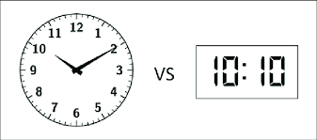
But what does ‘Digital’ mean?
The word "digital" refers to data or signals that are represented by discrete values.

Slide 5
Digital data
Analog data more closely mirrors real-world phenomena, it is difficult to process accurately using electronic systems because it is highly susceptible to noise, distortion, and signal degradation.
Digital data, on the other hand, is easier to store, process, and transmit with high precision. It allows for error detection and correction, making it more reliable over long distances and repeated use. Additionally, digital systems are more flexible and programmable, enabling a wide range of applications.

Slide 6
Digital vs Analog
Differences | Digital | Analog
Representation | Discrete | Continuous with varying magnitude
Signal form | Square waves | Sine waves
Response to noise | Less likely to get affected | Likely to get affected
Processing | Simple and programmable | Complex and less flexible
Storage | Easy and Accurate | Hard to store without loss

Slide 7
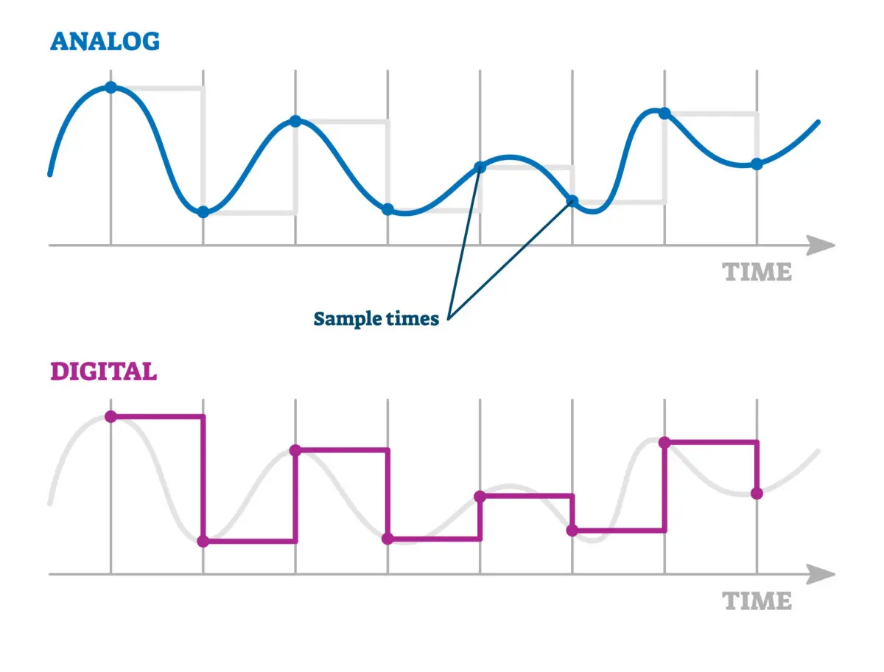
Digital vs Analog

Slide 8
Discrete Information
Voltages – HIGH or LOW
Switch States – ON or OFF
Time – 24 HOURS, 60 Minutes, 60 Seconds
Alphabets – 26
Number Systems

Slide 9
02
Number Systems
How do we represent values?

Slide 10
Number Systems
A number system is a way to represent and express numbers using a set of symbols (digits) and rules.
The most common number systems are –
Decimal
Binary
Octal
Hexadecimal

Slide 11
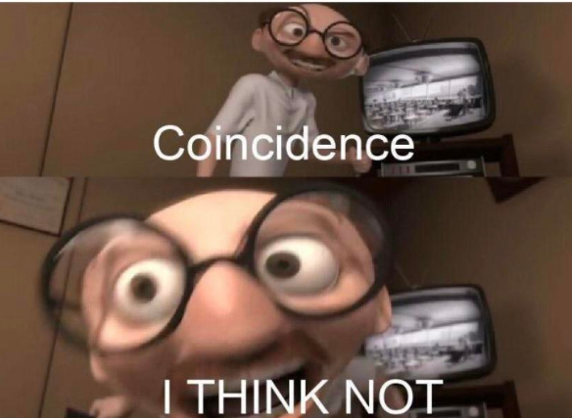
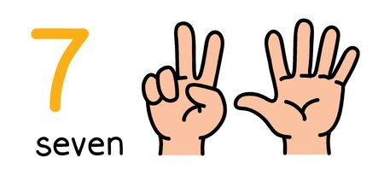
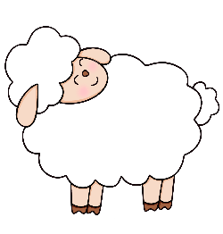
A Brief History of Numbers
Humans have 10 fingers and the natural number system contains 10 digits as well.
Long before writing, people counted using their hands, that likely shaped our earliest way of counting. The decimal system (digits 0–9) reflects our anatomy. It's not just practical — it's biologically inspired.

Slide 12
A Brief History of Numbers
Different civilizations had different number systems:
1. Arabs
As discussed before, number system with 10 digits.
Used by Romans, Indians, Chinese and Egyptians as well
2. Mayans
Used 20 digit number system.
Counted with fingers and toes.
3. Babylonians
The Babylonian number system used base 60 (sexagesimal) because of its high divisibility (by 1, 2, 3, 4, 5, 6, 10, 12, 15, 20, 30 and 60).
Babylonians tracked the movements of the sun, moon, and planets. They needed a system that allowed precise fractions, especially for time and angular measurements. (1 minute = 60 seconds, 1 hour = 60 minutes)

Slide 13
Common Number Systems
Number System | Base | Digits
Binary | 2 | 0,1
Octal | 8 | 0,1,2,3,4,5,6,7
Decimal | 10 | 0,1,2,3,4,5,6,7,8,9
Hexadecimal | 16 | 0,1,2,3,4,5,6,7,8,9, A, B, C, D, E, F
Base - number of unique digits (including 0) that the system uses to represent numbers.

Slide 14
Relationship between Base and Number of Digits
As the base (radix) of a number system increases, you need fewer digits to represent the same value.
But it comes with a trade-off, higher the based the more symbols you need, the harder it becomes to remember, write, and process numbers.

Slide 15
03
Number System Conversion
Convert numbers from one base to another

Slide 16
Number Systems Conversion
Decimal
Decimal → Binary
Binary → Decimal
Decimal → Octal
Octal → Decimal
Decimal → Hexadecimal
Hexadecimal → Decimal

Slide 17
Number Systems Conversion
Binary
Binary → Octal
Octal → Binary
Binary → Hexadecimal
Hexadecimal → Binary

Slide 18
Number Systems Conversion
Octal
Octal → Hexadecimal
Hexadecimal → Octal

Slide 19
Number Systems Conversion (in short)
Integer: Keep dividing the number by the target base. Read remainders in reverse (bottom to top).
Fraction: Multiply the fractional part by the base. Take the whole number part as the next digit. Repeat with the new fractional part.
Decimal → Any
Any → Decimal
Sum of product each digit by the base raised to its position
Binary → Octal/Hex
Group 3 (octal) or 4 (hex) bits
Octal/Hex → Binary
Convert each digit to 3 (octal) or 4 (hex) bits

Slide 20
Decimal → Binary
Convert (75.45)₁₀ to binary.
Integer
Fraction
2
75
LSB
MSB
.45
x 2
2
37
— 1
2
18
— 1
.90
x 2
0
2
9
— 0
1
.80
x 2
2
4
— 1
2
2
— 0
LSB
…..
2
1
— 0
2
0
— 1
(75.45)₁₀ = (1001011.01)₂
MSB

Slide 21
Decimal → Octal
Convert (75.45)₁₀ to octal.
Integer
Fraction
8
75
LSB
MSB
.45
x 8
8
9
— 3
8
1
— 1
.60
x 8
3
0
— 1
4
.80
x 8
MSB
LSB
…..
(75.45)₁₀ = (113.34)₈

Slide 22
Decimal → Hexadecimal
Convert (75.45)₁₀ to hexadecimal.
Integer
Fraction
16
75
LSB
MSB
.45
x 16
16
4
— 11 (B)
0
— 4
.20
x 16
7
3
.20
x 16
MSB
LSB
…..
(75.45)₁₀ = (4B.733..)₁₆

Slide 23
Binary → Decimal
Convert (1001011.01)₂ to decimal.
( 1 0 0 1 0 1 1 . 0 1 )
Positional Value
6 5 4 3 2 1 0 . -1 -2 )
(1001011.01)₂ = 1x2⁶ + 0x2⁵ + 0x2⁴ + 1x2³ + 0x2² + 1x2¹ + 1x2⁰ + 0x2⁻¹ +1x2⁻²
= 64 + 0 + 0 + 8 + 0 + 2 + 1 + 0.25
= (75.25)₁₀
(1001011.01)₂ = (75.25)₁₀

Slide 24
Octal → Decimal
Convert (113.34)₈ to decimal.
(113.34)₈ = 1x8² + 1x8¹ + 3x8⁰ + 3x8⁻¹ +4x8⁻²
= 64 + 8 + 3 + 8 + 0.375 + 0.0625
= (75.4375)₁₀
(113.34)₈= (75.4375)₁₀

Slide 25
Hexadecimal → Decimal
Convert (4B.73)₁₆ to decimal.
(4B.73)₁₆ = 4x16¹ + Bx16⁰ + 7x16⁻¹ + 3x16⁻²
= 64 + 11 + 0.4375 + 0.1172
= (75.449)₁₀
(4B.73)₁₆= (75.449)₁₀

Slide 26
Binary → Octal
Convert (10110101.11110)₂ to octal.
( 10 110 101 . 111 10 )
0
0
(10110101.11110)₂= (265.74)₈
2
6
5
7
4
Binary → Hexadecimal
Convert (10110101.11110)₂ to hexadecimal.
( 1011 0101 . 1111 0 )
000
(10110101.11110)₂= (B5.F0)₁₆
11(B)
5
15(F)
0

Slide 27
Binary → Octal
Convert (265.74)₈ to binary.
2
6
5
.
7
4
(265.74)₈=(10110101.111100)₂
010
110
101
.
111
100
Binary → Hexadecimal
Convert (B5.F)₈ to binary.
B
5
.
F
(B5.F0)₁₆=(10110101.1111)₂
1011
0101
.
1111

Slide 28
Octal ←→ Hexadecimal
Hexadecimal ←→ Octal
Octal ←→ Binary ←→ Hexadecimal
Hexadecimal ←→ Binary←→ Octal

Slide 29
Question
Find r such that (121)_{r}=(144)₈ , where r and 8 are the bases.

Slide 30
04
Binary Code
The Core of All Computational Logic

Slide 31
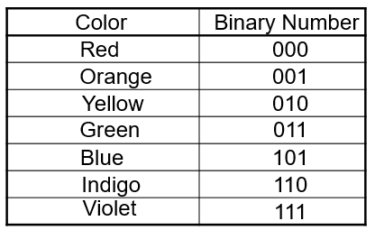
Binary Code
Given n binary digits (called bits), a binary code is a mapping from a set of represented elements to a subset of the 2^{n} binary numbers.
Example:
n = log₂ M

Slide 32
Binary Code
Number:
Represents a quantity or value. It’s used for counting, measuring, and performing mathematical operations.
Example: 5, 23, 100.
Process: Conversion
Code:
A representation of information or data, typically in a specific format. It’s used to encode data for storage or communication in computers.
Example: Binary code (101 for 5), ASCII code (01000001 for 'A').
Process: Encoding

Slide 33
Binary Code
There are several Binary coding schemes
Such as :
Binary Coded Decimal (BCD)
Excess -3
Gray

Slide 34
Binary Coded Decimal (BCD) (weighted)
In BCD, each decimal digit (0–9) is represented by its own 4-bit binary equivalent.
Decimal | Binary | BCD
5 | 101 | 0101
12 | 1100 | 0001 0010
93 | 1011101 | 1001 0011

Slide 35
Binary Coded Decimal (BCD)(weighted)
The weights of BCD scheme might vary,
Decimal | 8421 BCD | 84-2-1 BCD | 2421 BCD
7 | 0111 | 1001 | 1101
2 | 0010 | 0110 | 0010
9 | 1001 | 1111 | 1111
6 | 0110 | 1010 | 1100
0 | 0000 | 0000 | 0000
3 | 0011 | 0101 | 0011

Slide 36
5043210(Bi-quinary)(weighted)
Weighted coding scheme consisting of exactly 2 ones.
Example :
Decimal | 05-01234
0 | 10-10000
1 | 10-01000
2 | 10-00100
3 | 10-00010
4 | 10-00001

Slide 37
Excess-3(unweighted)
Obtained from the corresponding BCD+3
Decimal Digit | BCD (8421) | Excess-3 Code
0 | 0000 | 0011
1 | 0001 | 0100
2 | 0010 | 0101
3 | 0011 | 0110
4 | 0100 | 0111
5 | 0101 | 1000

Slide 38
Excess-3(unweighted)
Convert (15)₁₀ to Excess-3
Step 1: Convert (15)₁₀ to BCD.
(0001 0101)_{BCD}
Step 2: Add (3)₁₀ or (0011)_{BCD} to each BCD chunk.
(0100 1000)_{BCD}
Excess–3 is self complementing code!!

Slide 39
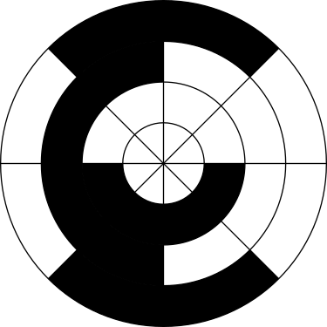
Gray Code(unweighted)
Gray Code, also called Reflected Binary Code, is a binary numeral system where two successive values differ in only one bit. This property is known as single-bit change, and it's what makes Gray code special compared to standard binary.

Slide 40
Gray Code(unweighted)
Binary to Gray
Gray to Binary
B₃
B₂
B₁
B₀
G₃
G₂
G₁
G₀
⊕
⊕
⊕
⊕
⊕
⊕
G₃
G₂
G₁
G₀
B₃
B₂
B₁
B₀

Slide 41
Gray Code(unweighted)
Decimal | Binary | Gray Code
0 | 000 | 000
1 | 001 | 001
2 | 010 | 011
3 | 011 | 010
4 | 100 | 110
5 | 101 | 111
6 | 110 | 101
7 | 111 | 100

Slide 42
05
Alphanumeric Codes
Codes containing numbers and characters

Slide 43
Alphanumeric Codes
An alphanumeric code is a sequence of characters that includes both letters (alphabetic) and numbers (numeric).
ASCII (American Standard Code for Information Interchange)
Represents 128 characters (7-bit): A–Z, a–z, 0–9, symbols, and control characters
EBCDIC (Extended Binary Coded Decimal Interchange Code)
IBM-developed 8-bit code used in mainframes
Unicode (UTF-8, UTF-16, etc.)
A universal character set for all languages, emojis, symbols. Encodes over 140,000 characters

Slide 44
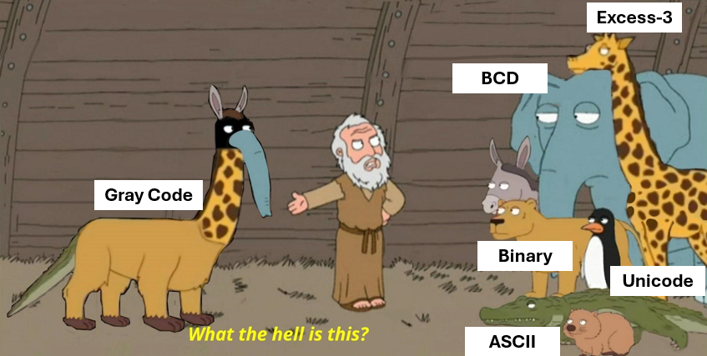

Slide 45
Thank You !!
Feel free to ask any questions

